Slide 1
Best Practices for Metallics, Ceramics, Fabrics, and more
Greg Radencic, Tech. Mgr., MBS/ SGK

Slide 2
Background
MBS/ SGK… We manage brands
Concept to market
Color Development
Design
Prototyping
File Production
Press Proofs
Production
Quality Assurance
Asset Management (color & file)

Slide 3
What MBS Pitt Team Does
MBS Pitt
Color Development- We have a color formulation lab that can create colors on a variety of substrate and print processes.
Prototyping- We have the tool, techniques and resources to make one-off’s, sales samples, short production runs, and concepts.
File Production- SCARY!!!!- We work the files to address the process required to make Production files and those used to create Prototypes.

Slide 4
Why is Prototyping Difficult???
Color- We are not dealing with production inks in all cases… We have to deal with transparency, overprint, out-of-gamut, gloss, reflectiveness, etc..
Screening- A lot of packaging is done flexo. Flexo has some issues that are hard to replicate in a proofing/ prototyping environment, we call this glamor comps.
Equipment- We don’t have a litho or flexo press on hand with 10+ units to product these.

Slide 5
Why do we do it?
Clients need it for decision making processes.
Photo-shoots/ advertising before production.
Required for designing other parts.
We can make money at it!

Slide 6
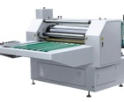
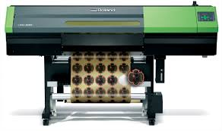
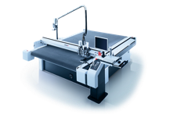
Production Techniques
Running on a single digital device does not cut it.
Requires New-School & Old-School techniques.
We run same prototype through multiple devices.
Often requires integrate hand work.
Some projects require partnering with other who have expanded capabilities

Slide 7
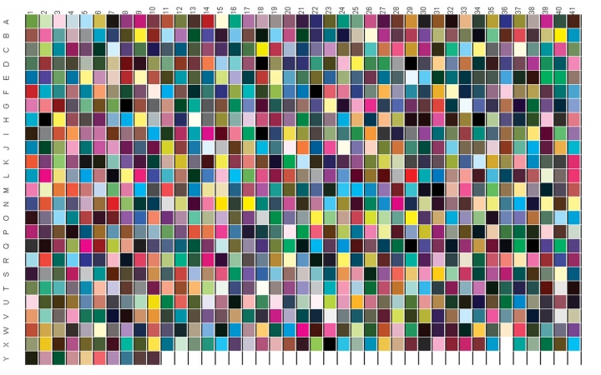
Managing Color
Two types of prototypes
Pretty color
Color accurate simulation
Simulation of print process
Dot gain curves (process/ spot)
Min. dots
Color gamut of print technique
Expanded gamut/ 4c Process/ Spot

Slide 8
Managing Color
What if we don’t know…
Typically we have a general idea of print process, we have created simulation profiles.
Use industry standards to address: solid, tone, overprint information
Communicate expectations and thought process with parties involved.
Communication allows us to understand how much Wow! we apply.

Slide 9
Managing File Needs
Design file comes in
Prototype Request
Carton
Production Request
Design for other components
Inkjet
Analog
Varnish
Layer Cut
Printer defined
Print process defined
Print spec. applied
Proofing color match confirmed
Label (size change)
Corrugate box

Slide 10
ReCap
There is a demand for protyping, concepts, and one-off’s
You can’t do it with just an inkjet
Be prepared to staff to have Arts-and-Kraft’s day (hand assembly)
You will need to know and understand the product and how final production will run… there is a need to represent full scale production

